Slide 1


Elephant vs Donkey
— 2020 President Election Prediction
Data Samurai
Annan CHEN, Tianqi SHEN, Bingsu MO, Xiaoya XU
Dec 4, 2019
Notes:
El

Slide 2
Overview
Gradually Losing Smiles?
“President Donald Trump had abused the power of the presidency by withholding both military aid and a White House meeting as a means of pressuring Ukraine’s newly elected president, Volodymyr Zelensky ”
----Impeachment inquiry against Donald Trump
“The report, which states that the president “sought to undermine the integrity of the U.S. presidential election process, and endangered U.S. national security,” was approved on a party-line vote. ”
----Washington Post on Dec 3rd, 9:12 p.m.

Slide 3

Overview
Algorithms
Data Cleaning
Gradient Boosted Tree
XG Boost
SVR
Linear Regression with Regularization
Modelling & Validation
Census
Data Visualization
Prediction
Result
Different Candidates
Text Mining
Sentiment Analysis
Candidate Popularity Comparison
WordCloud
Verification
Twitter

Slide 4
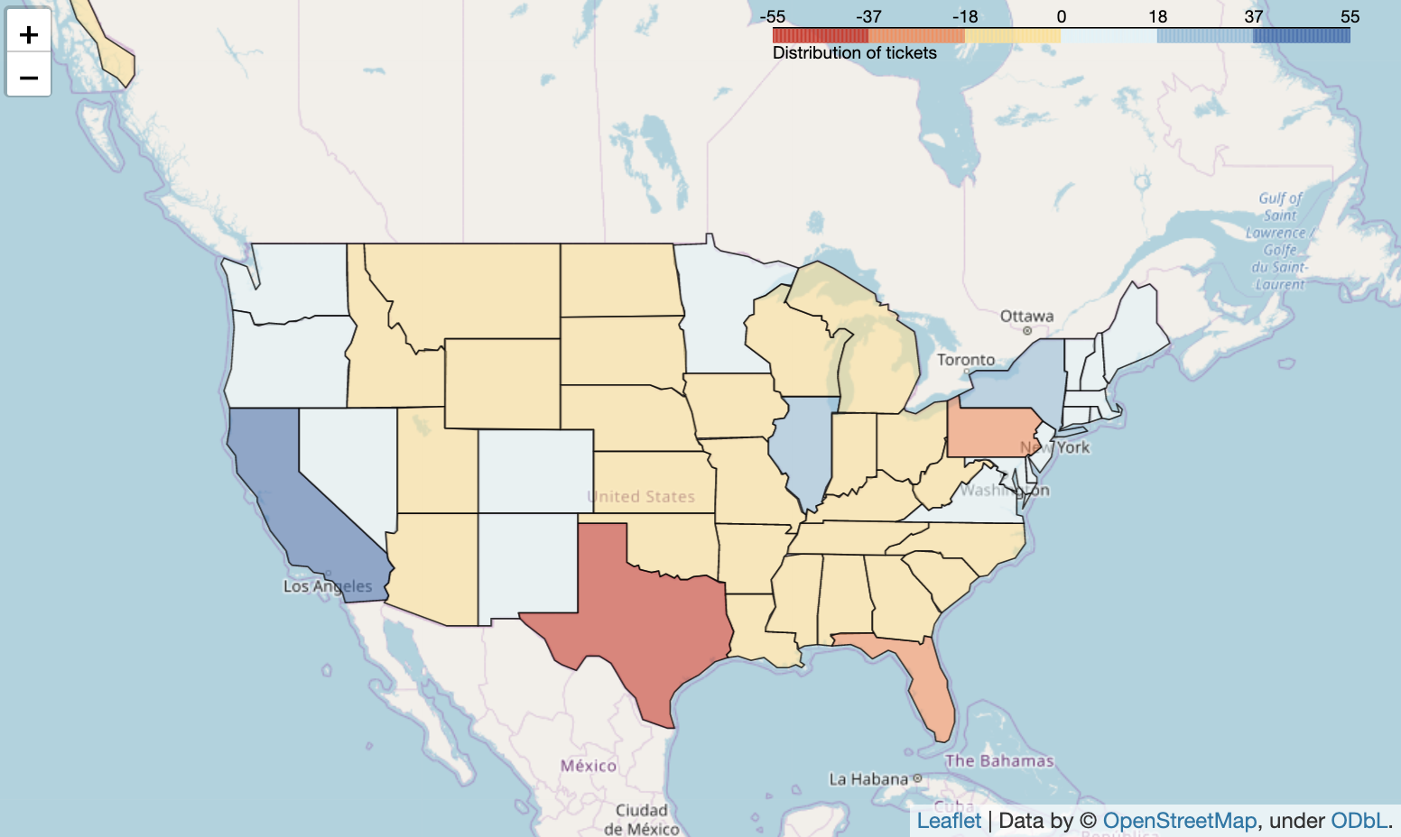
Prelim — President Election
Basic Rules for each state:
“Winner Takes All!”
2016 U.S. Presidential Election Result
California (CA): 55
Texas (TX): 38
Florida (FL): 29
New York (NY): 29
Pennsylvania (PA): 20
NY
PA
CA
TX
FL
538 Votes In Total
“I got 304”
“I had 332”
Notes:
So how many of you knows about US president election?
Each state will has a number of state tickets, and it will all gives to the candidate that has more votes in this state.
But how can we know which state will vote whom? Let’s first break this big question into small part, let’s see how you and me make decision.

Slide 5

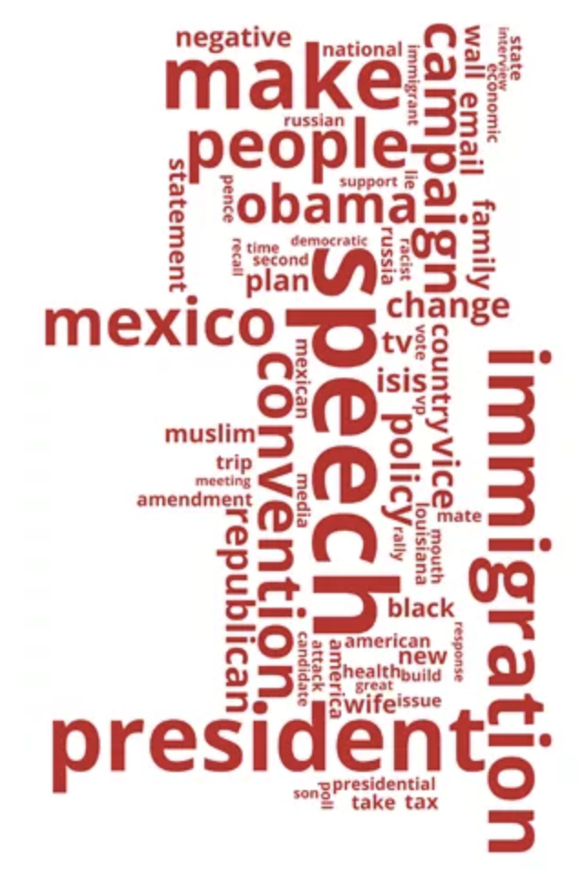


Dataset — part 1
Data Composition:
An Indecisive Voter
Notes:
Suppose

Slide 6








Dataset — part 1
Data Composition:
Unemployed Rate
Labor Force
Working Agriculture
EMPLOYMENT
Health Insurance Coverage
White People
HEALTH CARE
RACE
Bachelor Holders
Turnout
Previous vote
EDUCATION
ELECTION
ECONOMY
Gini Coefficient

Slide 7

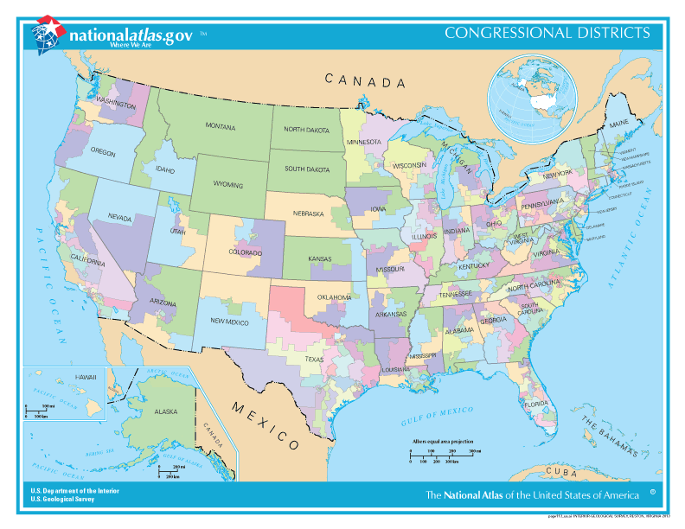
Dataset — part 1
Data Source:
United States Census Bureau (Census API)
American Community Survey (ACS) – 1 year
Data Items:
Congressional District (435)
Data Features (44):
Census Data, Turnout, Approval Rate, etc.
Notes:
For example, aruba is a student now living the U.S, how can we know what is his preference

Slide 8
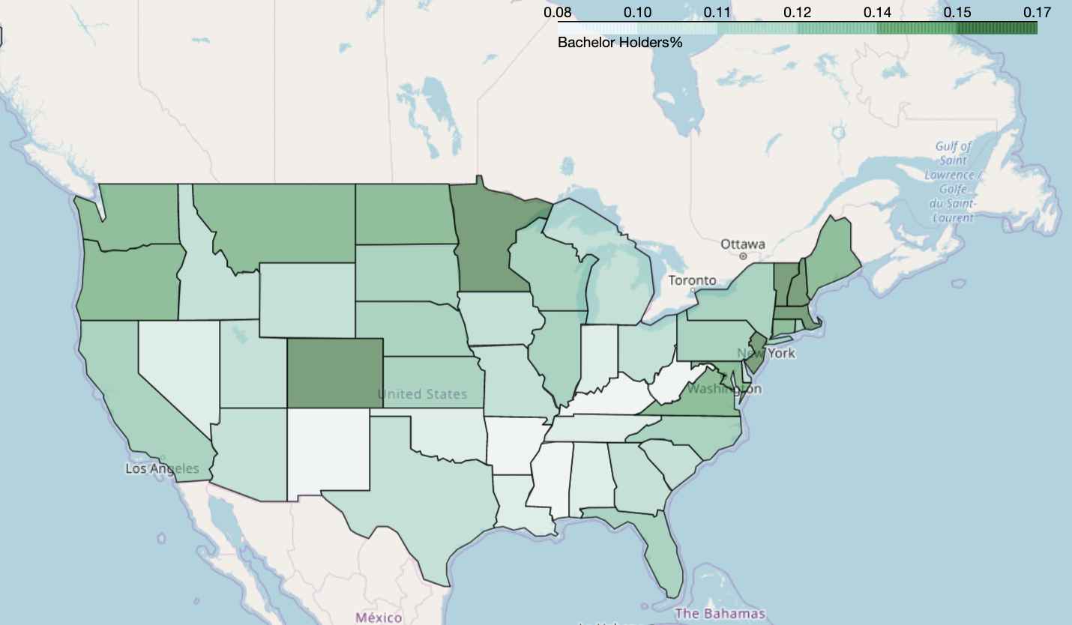
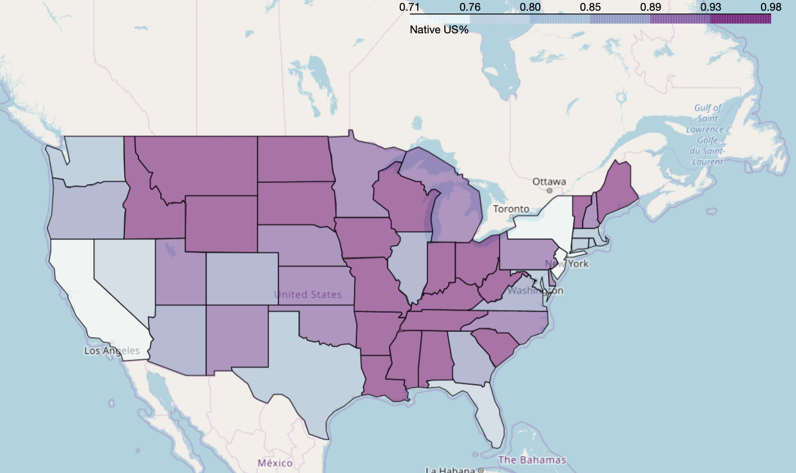
Dataset — part 1
People Holding Bachelor Degree(%), 2016
Native US people(%) in the U.S., 2016
ND
MI
MI
MA
NY
CO
CO
CA
Notes:
But there are so many variables that can describe a state, even if we know, for example, the health condition or income level of a state, we still can not tell what will these affect the result
and how can we know which are the important ones? and how can we use these important features to make prediction for 2020 – that is, will Trump still sit in the white house this time in the next year.
That welcome BINGSU to introduce our feature engineering method and the modeling part.

Slide 9
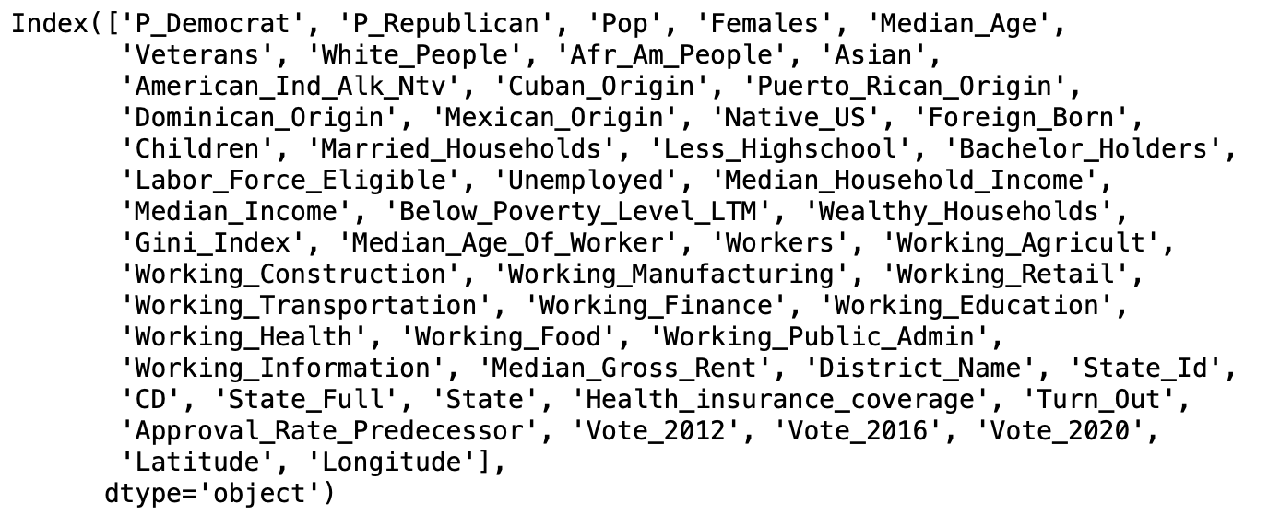
Feature Transformation
Categorical Variable: State name – Longitude/Latitude
Numerical Variable (Normalization): Population composition
Numerical Variable (Standardization): Mean – 0; Variance - 1
Dependent Variable: The difference between votes for two parties (percent)

Slide 10
Algorithms
Metrics: The square root of mean squared error based on cross validation on training data
It builds the model in a stage-wise fashion like other boosting methods do, and it generalizes them by allowing optimization of an arbitrary differentiable loss function.
Gradient Boosted Tree
XG Boost is an optimized distributed gradient boosting library designed to be highly efficient, flexible and portable.
XG Boost
Support-vector machines (SVMs) are supervised learning models with associated learning algorithms that analyze data used for classification and regression analysis.
SVR
Lasso/Ridge
Regression
Lasso/Ridge are regression analysis methods that perform both variable selection and regularization in order to enhance the prediction accuracy. The lowest root MSE: 5.8%

Slide 11
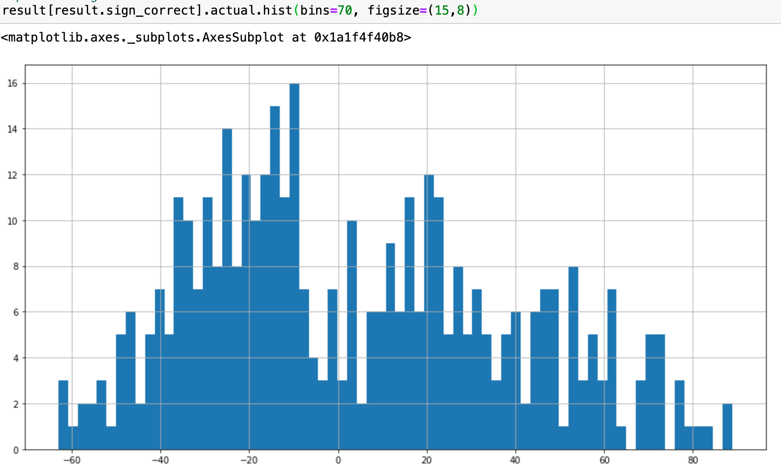
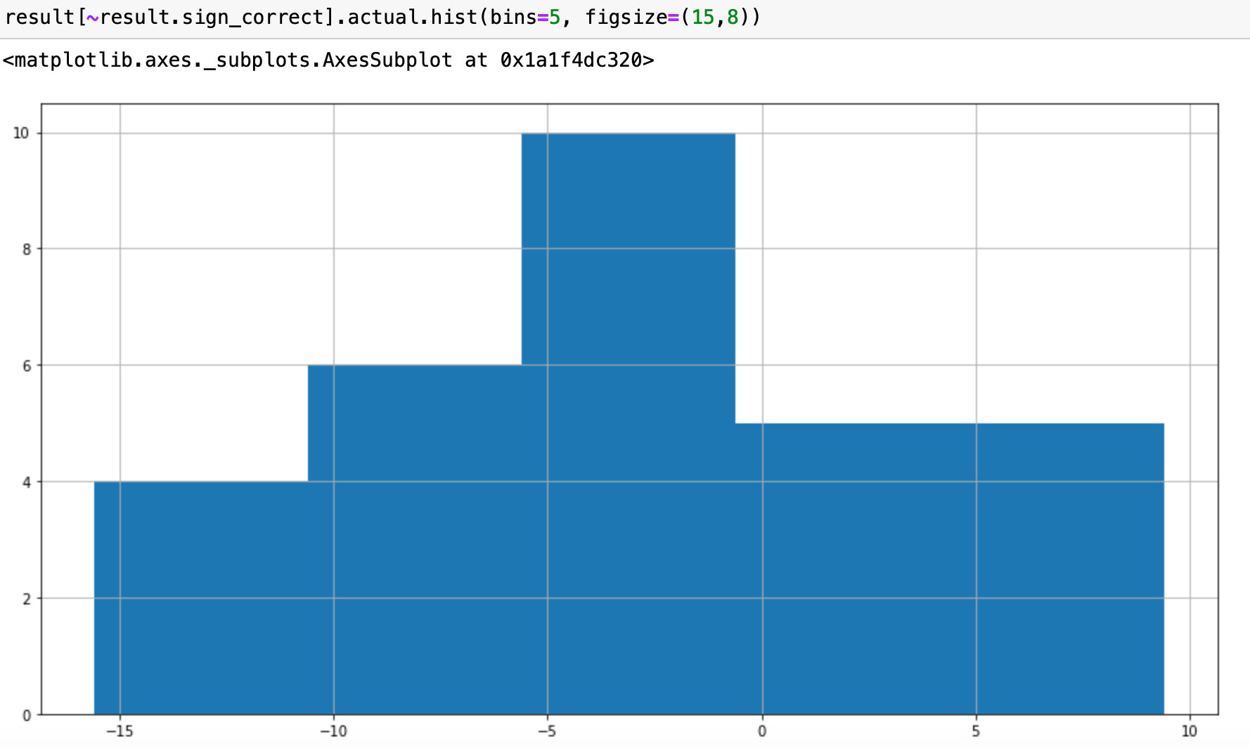
Validation
Validation on 2016 testing data: Root MSE is 8.9%
93% of validation data has correct winner prediction at CD level
Feature importance at national level

Slide 12
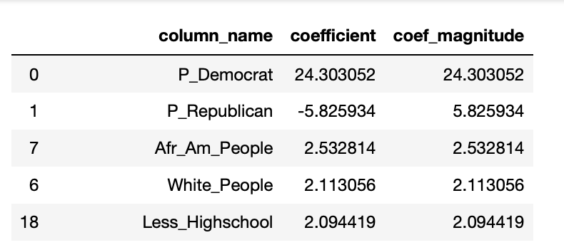
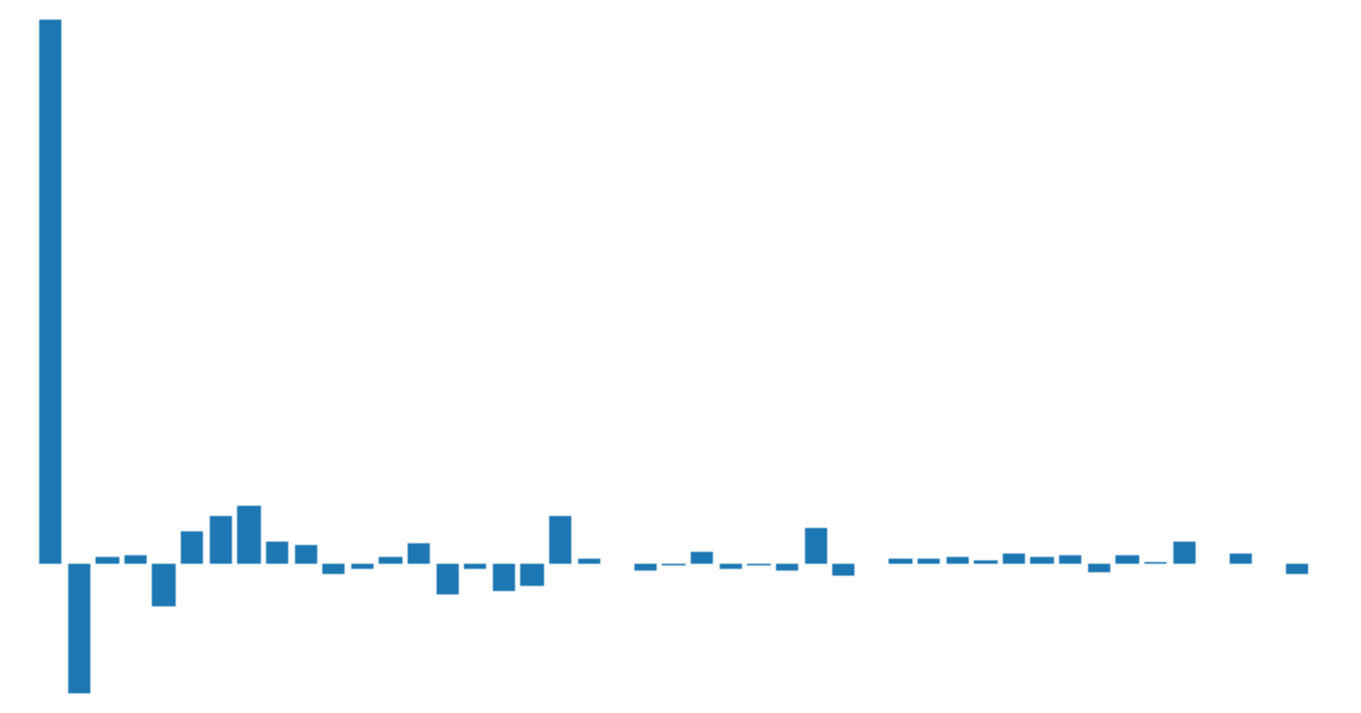
Feature Importance
National wide: Coefficient ranking of lasso regression
Validation on 2016 testing data: Root MSE is 0.089

Slide 13
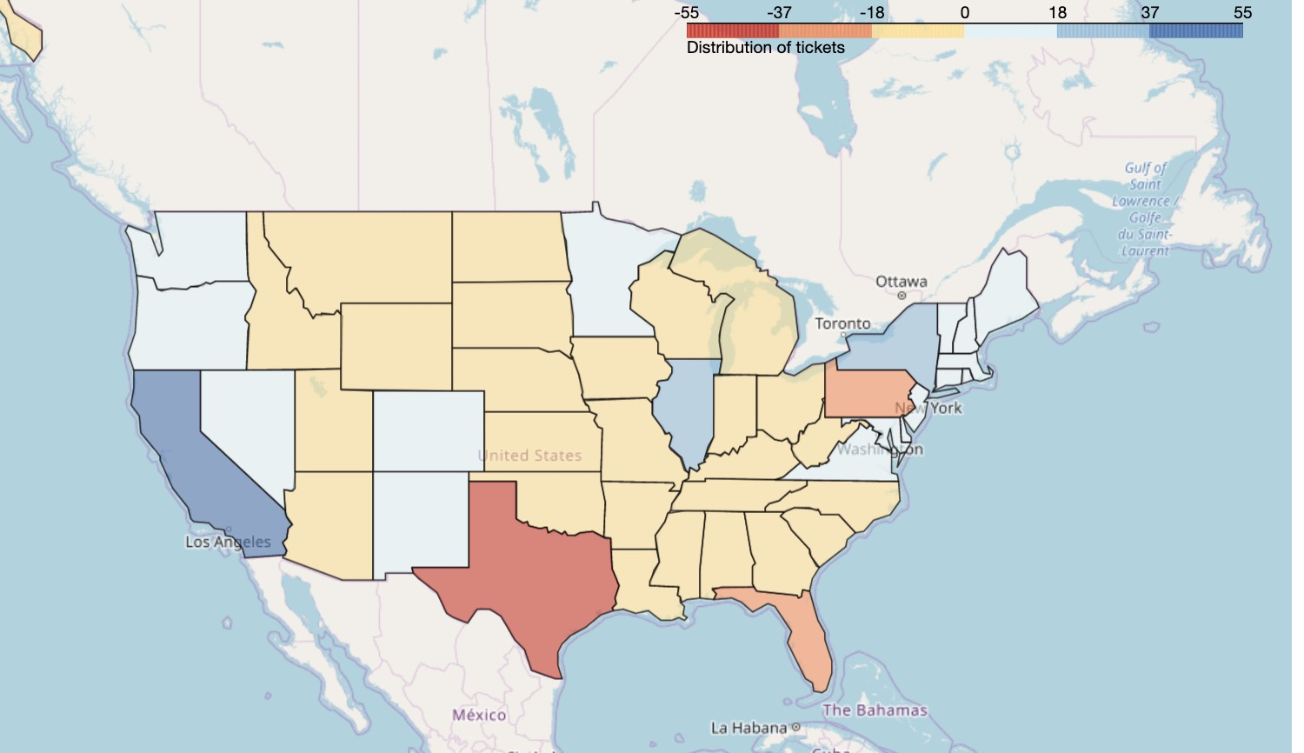
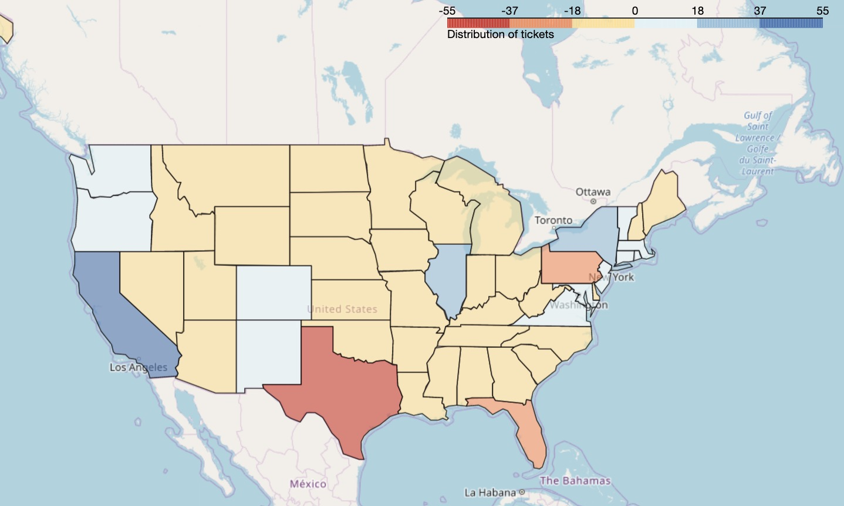
Vote Comparison(2016, 2020)
Validation on 2016 testing data: Root MSE is 0.089

Slide 14
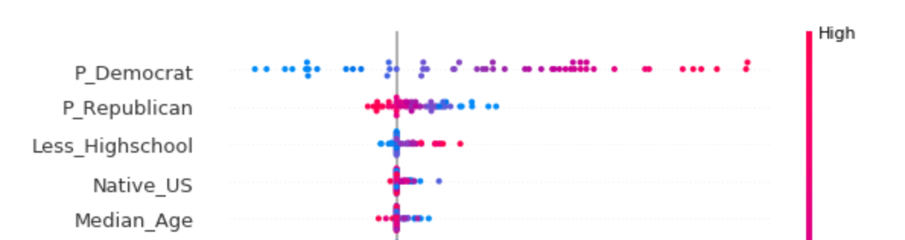
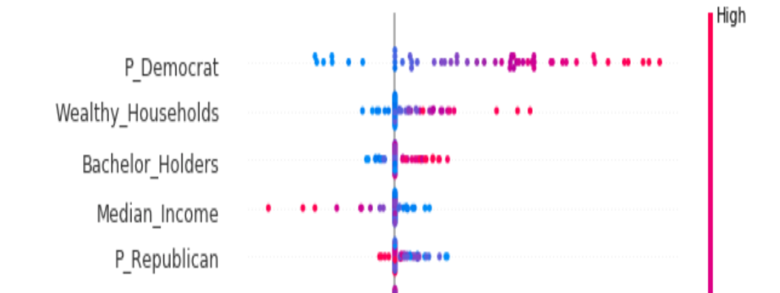
Why a different party?
SHAP, explain output for every data in the sample
2016 for California:
Validation on 2016 testing data: Root MSE is 0.089
2020 for California:

Slide 15

However, is it too naive to make prediction without considering candidates’ personal characteristics?

Slide 16
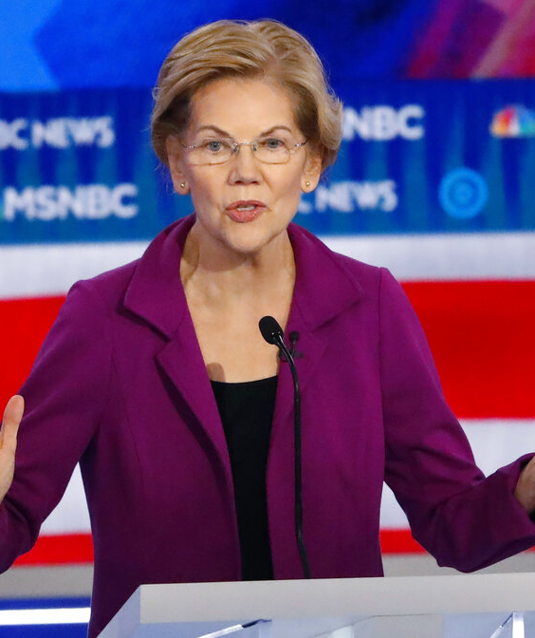
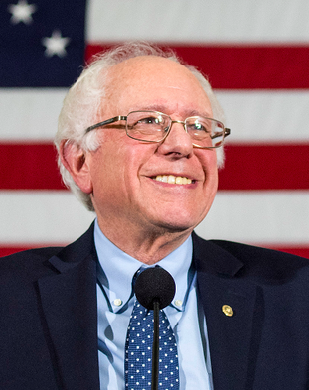

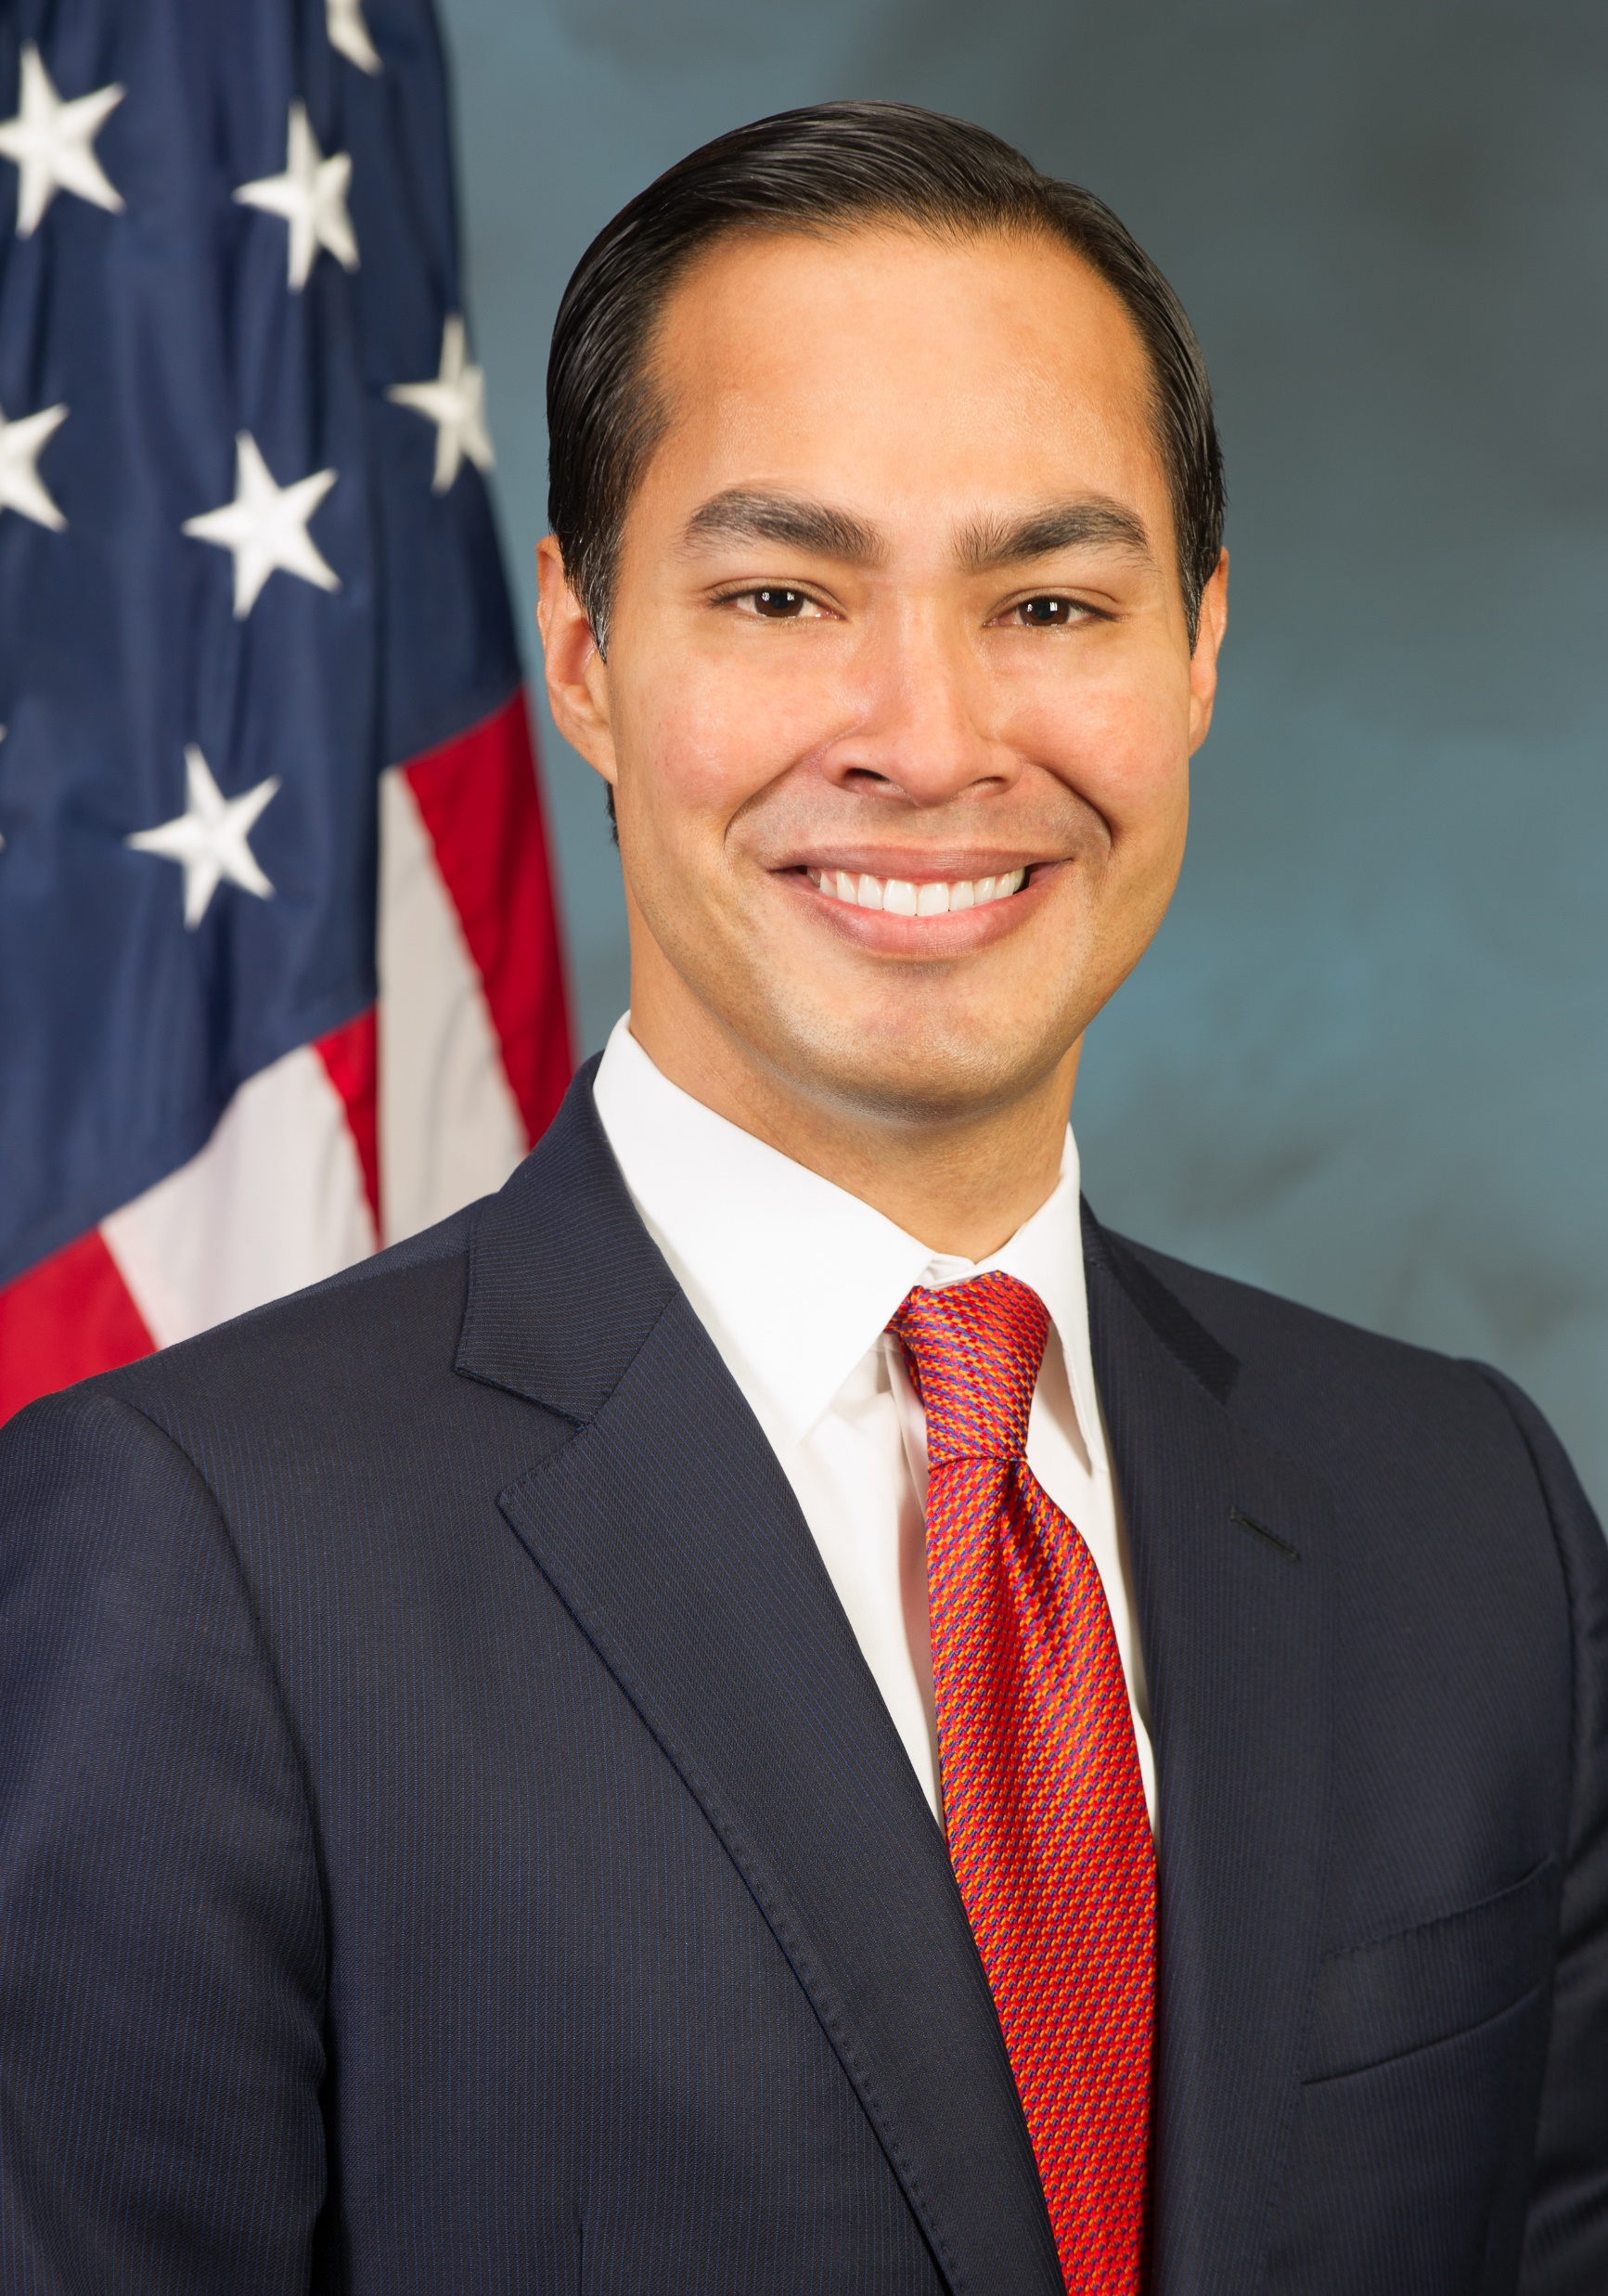

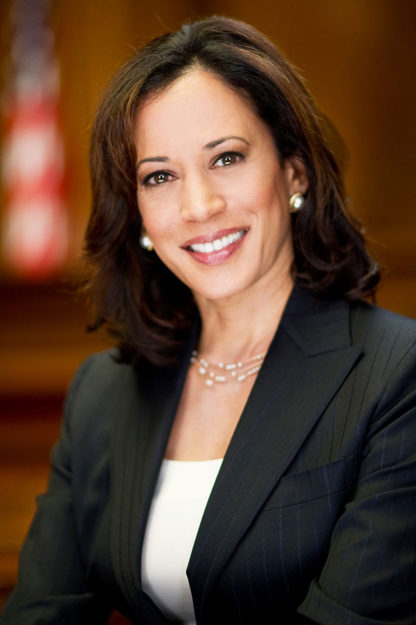
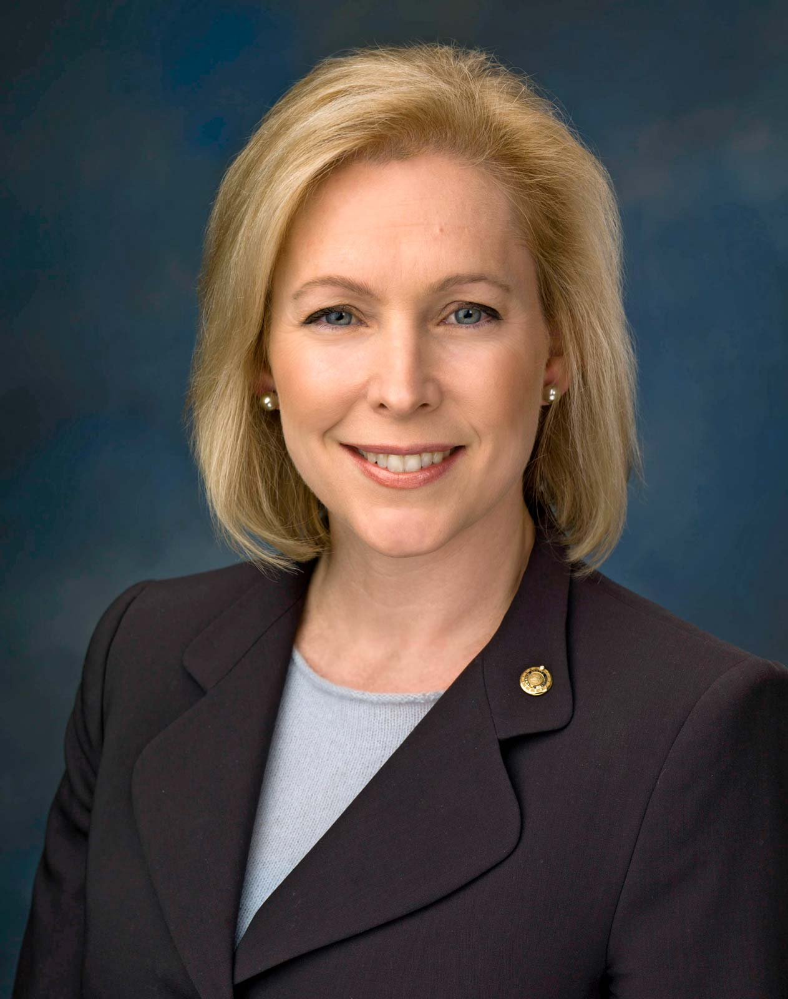
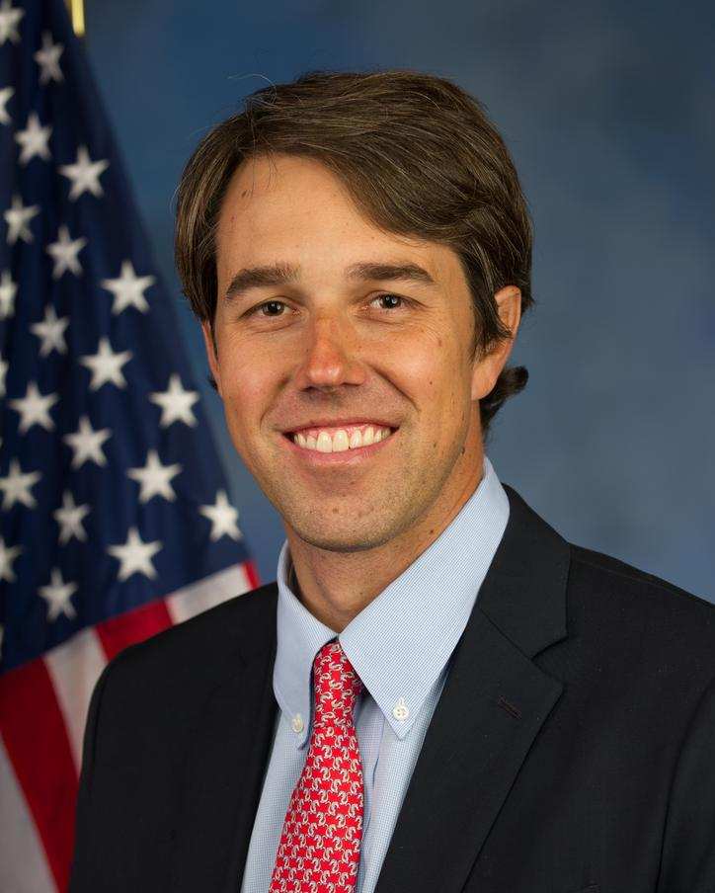
Dataset — part 2
Democratic
Candidates:
Republic
Elizabeth Warren
Bernie Sanders
Cory Booker
Julián Castro
Donald J. Trump
Kamala Harris
Kirsten Gillibrand
Beto O'Rourke

Slide 17


Dataset — part 2
Data Source:
Twitter (Through Twitter API and tweepy package)
1.We get each candidates’ tweets and related likes and retweets through web scraping. For each candidates, we get their most recent 3000 tweets due to Twitter API limits.
2. We also derive the most recent tweets that mentioned our target candidate
Fun Fact:
For president Trump, 3000 tweets only takes us back to Aug 2019, which means president Trump tweets approximately 20 times a day on average. (including retweets)

Slide 18
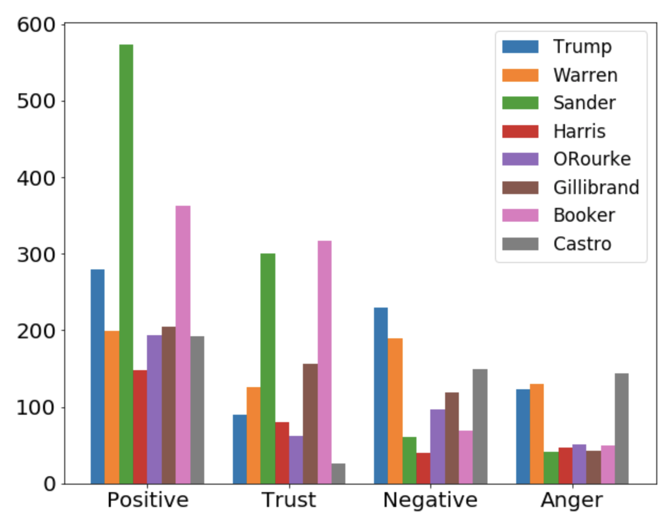

Sentiment Analysis
We search different candidates’ name on Twitter
NRC data
We choose 2 sentiments and 2 emotions as comparison basis
Positive
Negative
Trust
Anger
Result: Bernie Sander and Cory Booker are highly competitive

Slide 19
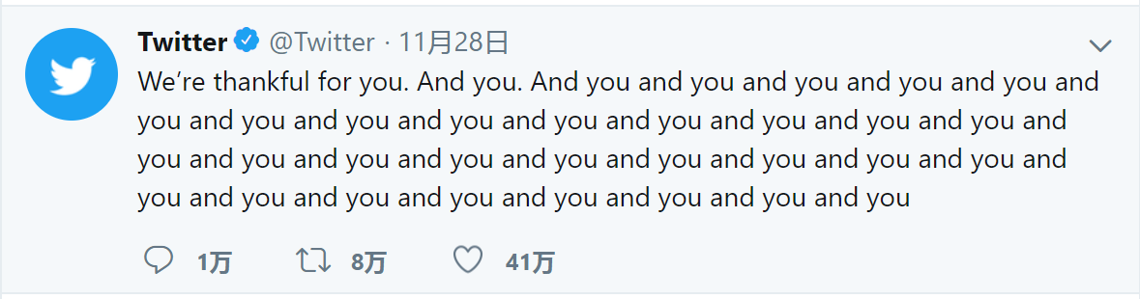
Comparison Regarding Likes/Retweets
We scrape each candidate’s most recently 3000 tweets due to twitter API limits
We analyze their weekly average likes / reweets

Slide 20


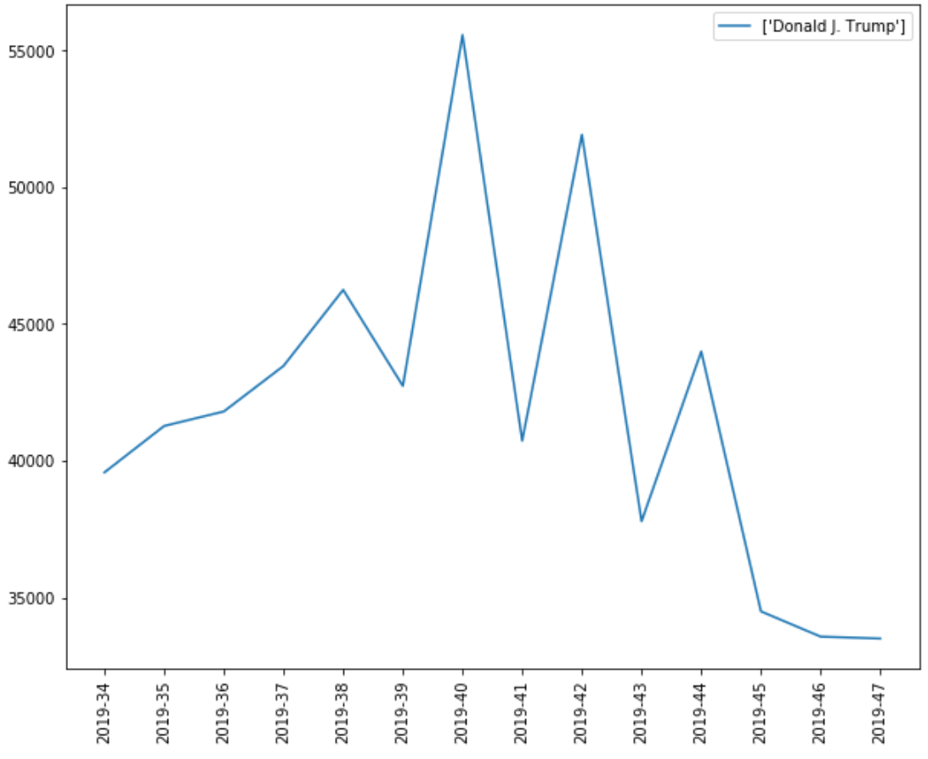
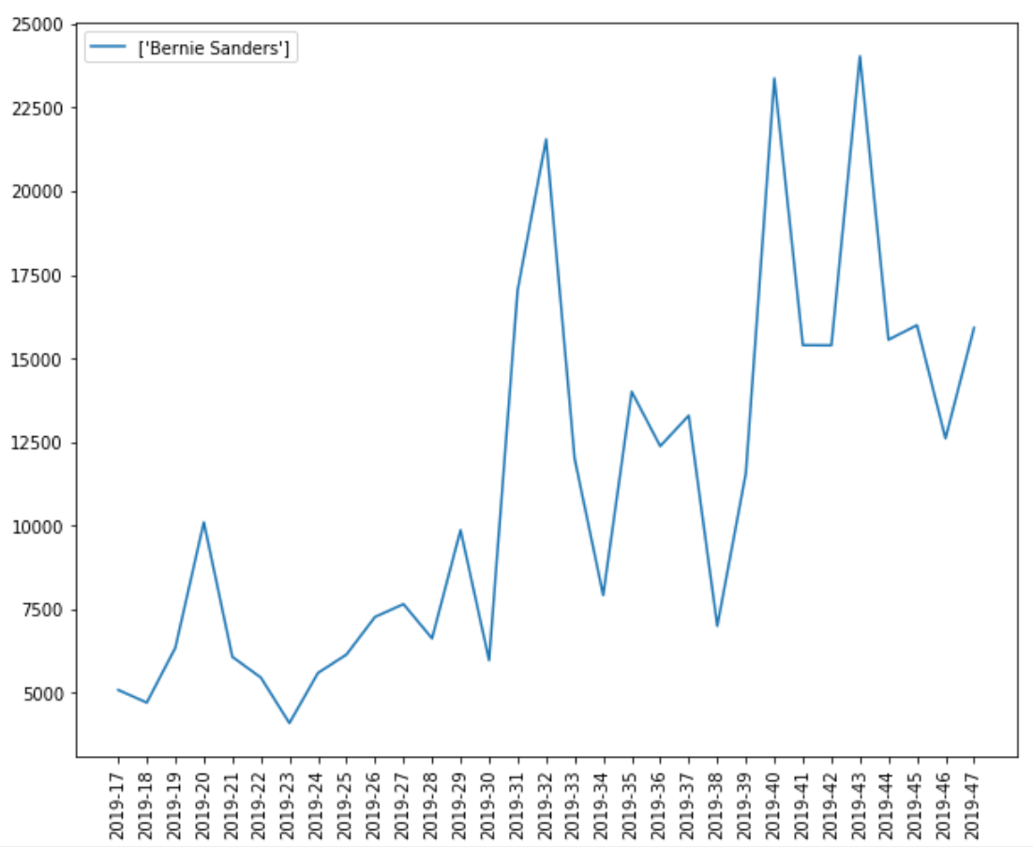
Monthly Average Likes
Donald J. Trump
Bernie Sanders
Highest weekly average likes reaches 55,000 a week
Highest weekly average likes is less than
half of president Trump’s

Slide 21
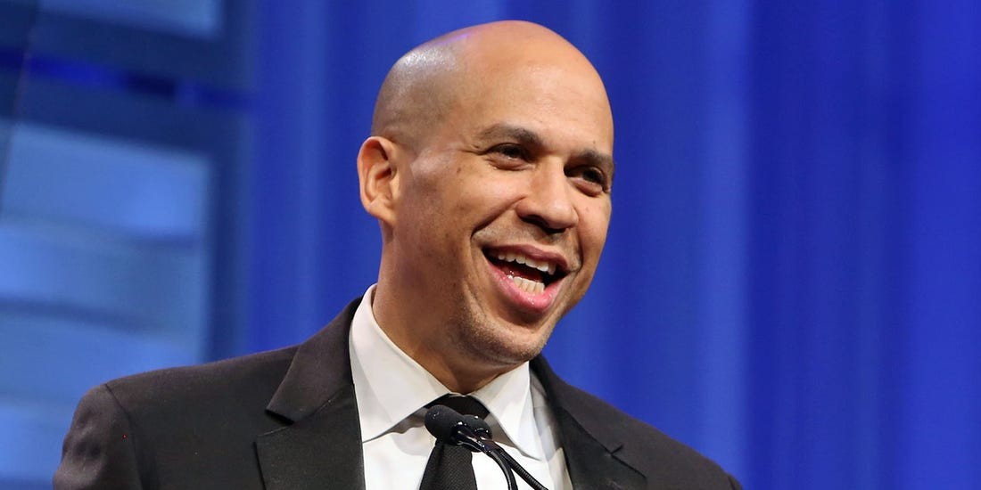
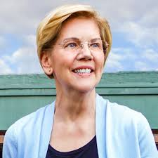
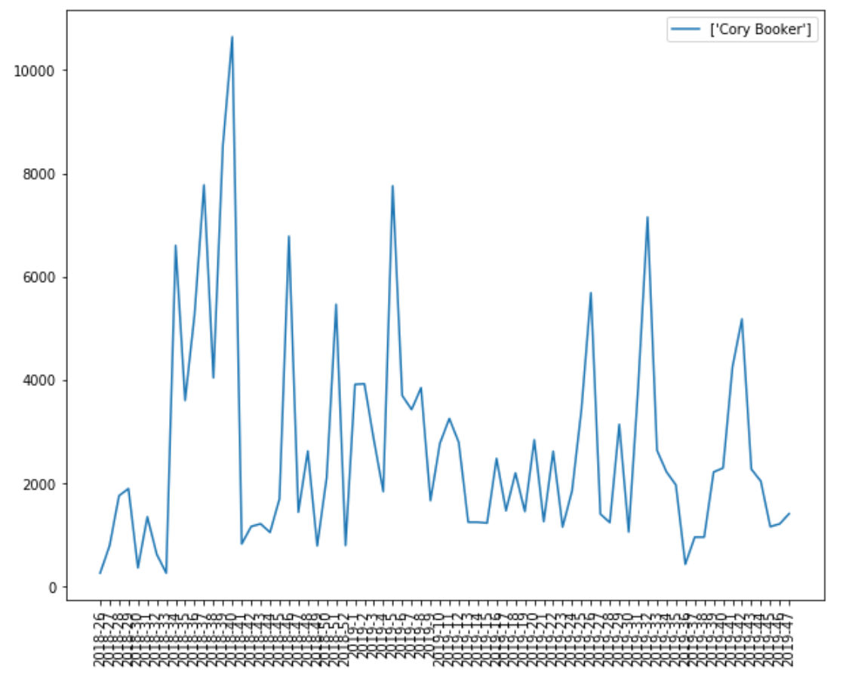
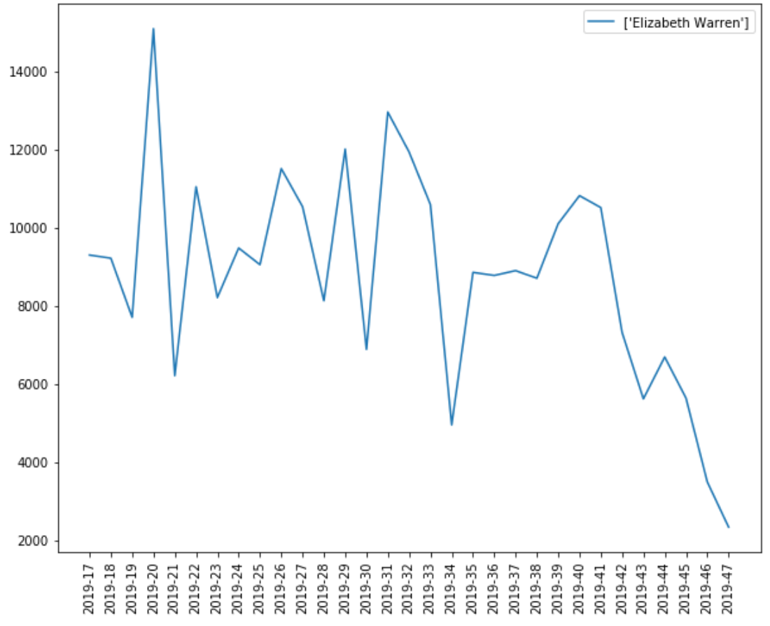
Monthly Average Likes
Cory Booker
Elizabeth Warren

Slide 22
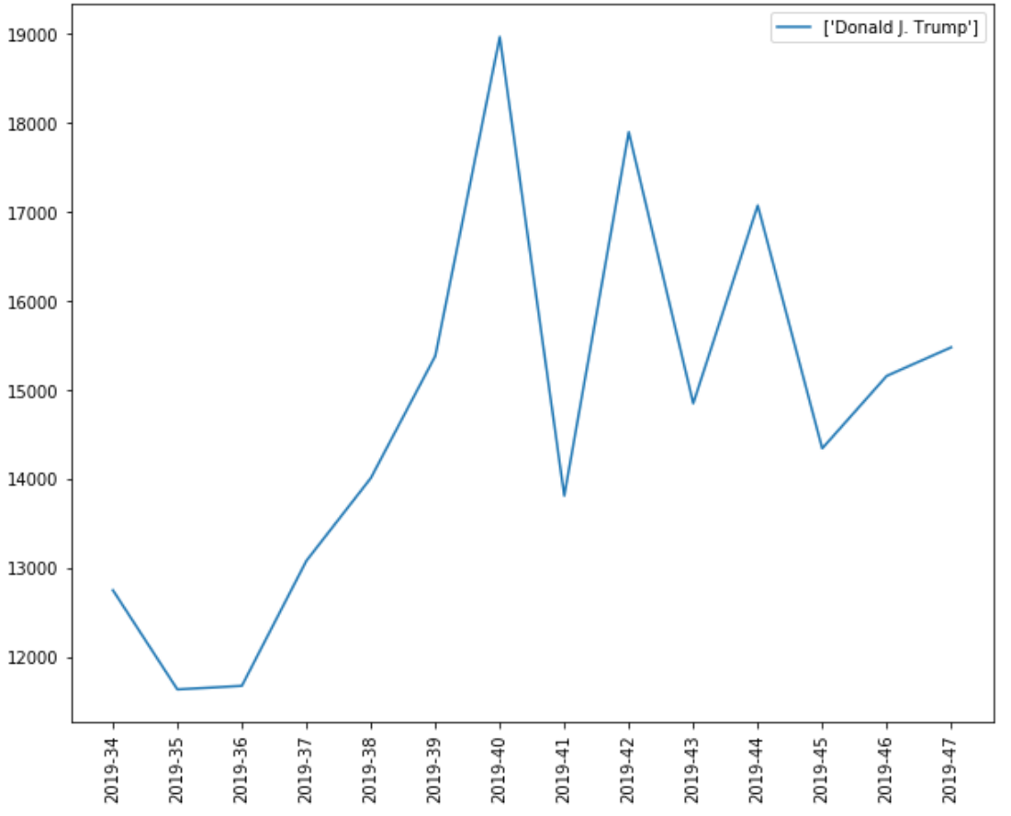
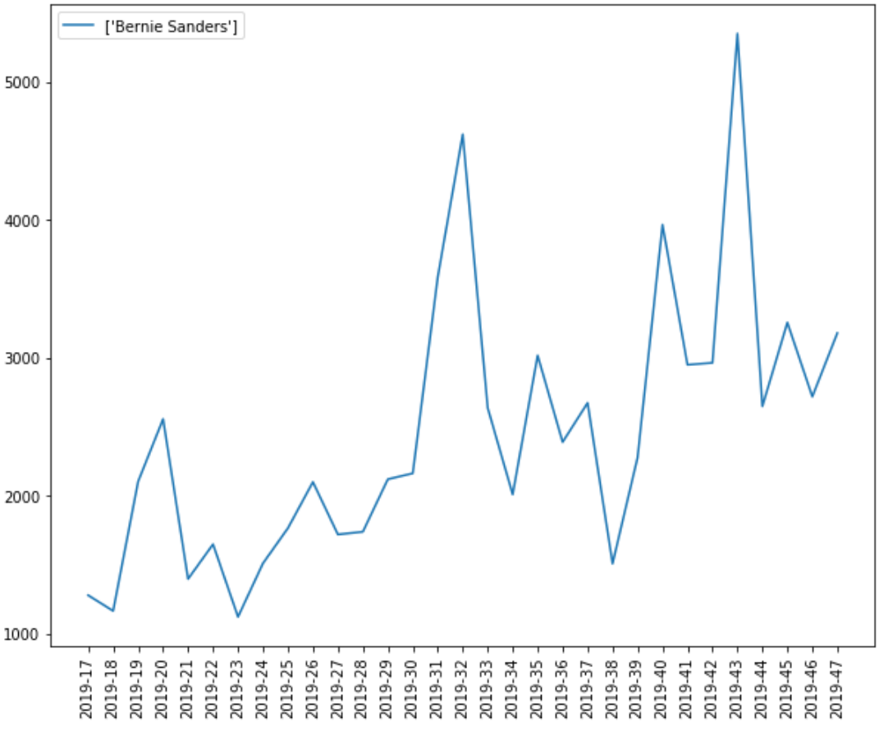
Monthly Average Retweets
Donald J. Trump
Bernie Sanders
Highest weekly average retweets reaches
19,000 a week
Highest weekly average retweets
is around one thirds of president Trump’s.

Slide 23
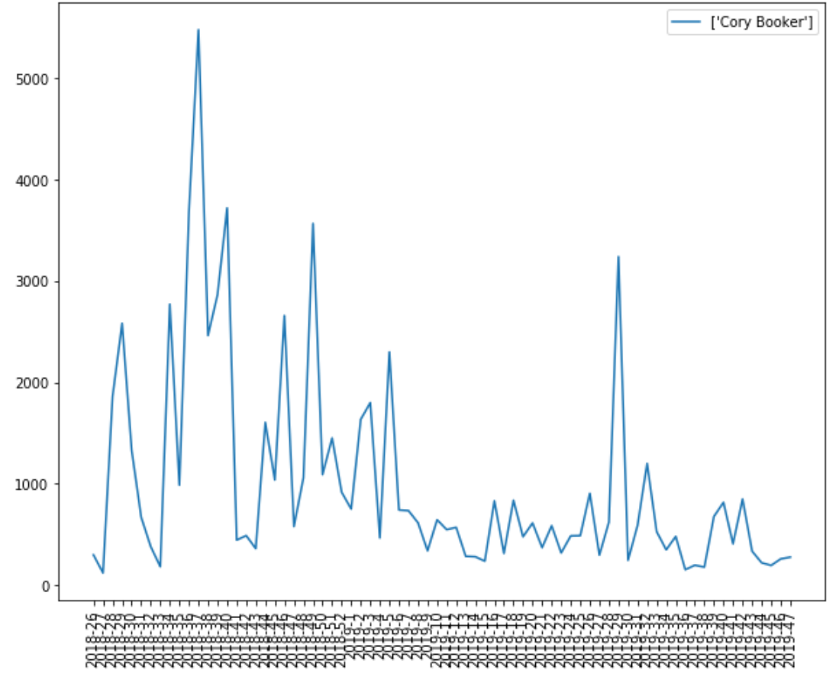
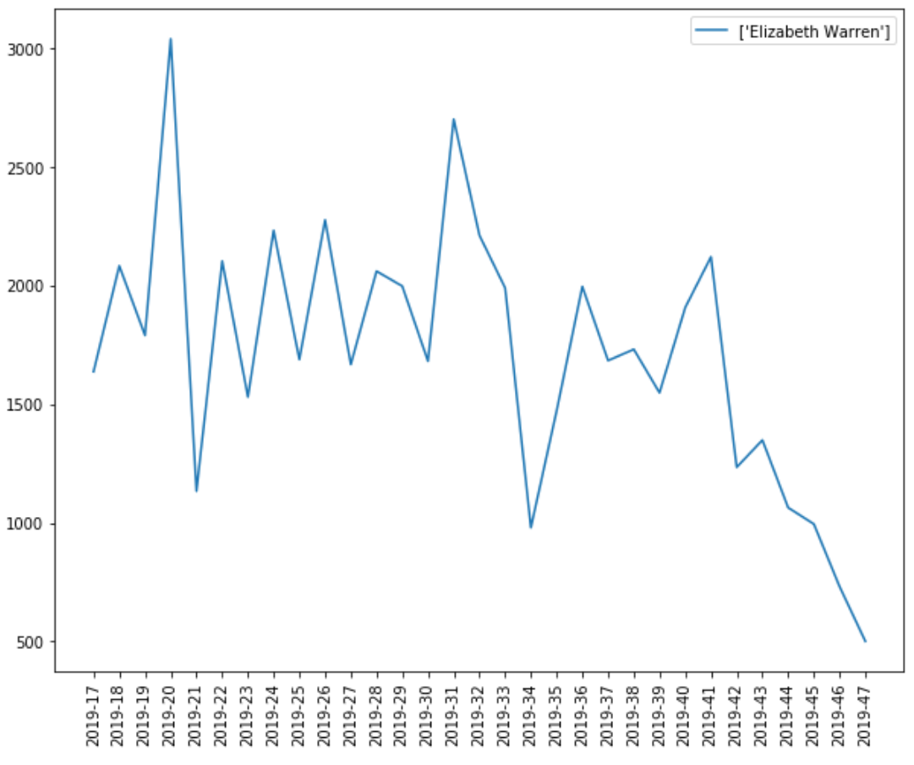
Monthly Average Reweets
Cory Booker
Elizabeth Warren

Slide 24
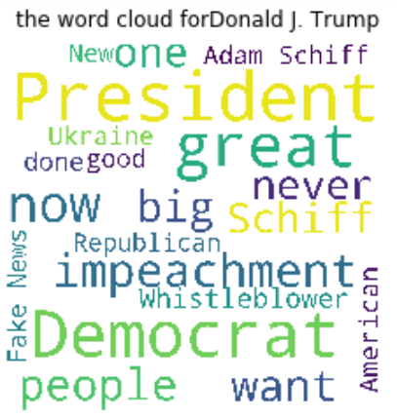
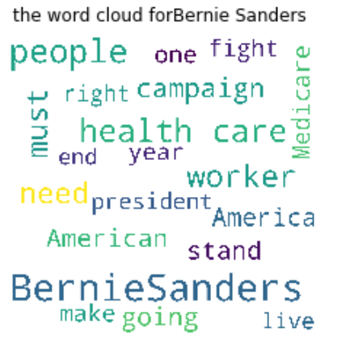
Comparison Regarding WordCloud
Donald J. Trump
Bernie Sanders

Slide 25
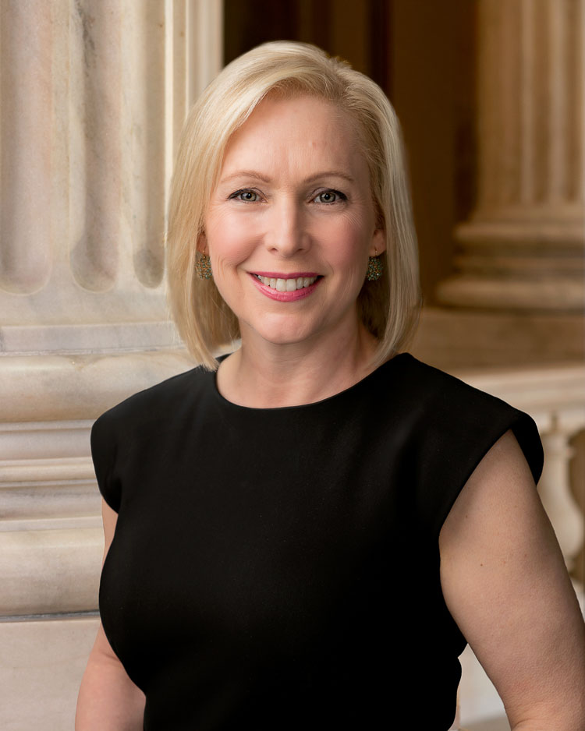
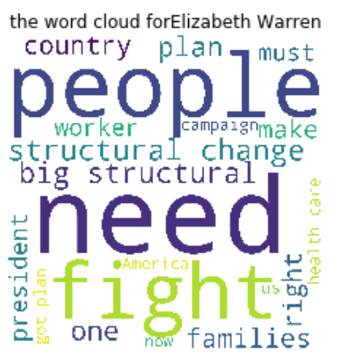
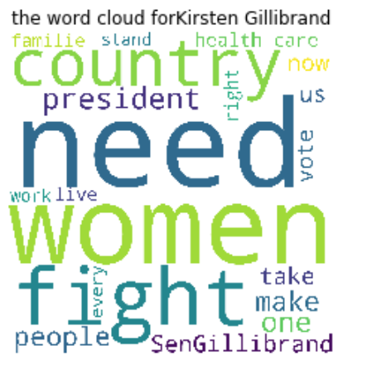
Comparison Regarding WordCloud
Elizabeth Warren
kirsten Gillibrand

Slide 26
Conclusion
Although the attitudes towards Mr. Trump in general are not very positive, he is still considered as the most popular candidate based on data from twitter, which provides him with a large potential in gaining citizens’ attentions as well their votes.
This further verifies the prediction result of our models.

Slide 27


